Slide 1
J’dêchèrge d’la musique/ des vidgos
J’dêchèrgis
J’m’en vais dêchergi
J’chèrge des portraits/ des vidgos
J’chèrgis
J’m’en vais chèrgi
J’èrgarde des vidgos comiques
J’èrgardis
J’m’en vais r’garder
Jé châre des postes/ portraits / vidgos
Jé châris
J’m’en vais chârer
J’poste des commentaithes
J’postis
J’m’en vais poster
J’lié d’s articl’yes en lîngne
Jé lius
J’m’en vais liéthe
J’caqu’te auve m’s anmîns
J’caqu’tis
J’m’en vais caqu’ter
J’fais des r’chèrches pouor man travas
J’fis
J’m’en vais faithe
J’êcoute d’la musique
J’êcoutis
J’m’en vais êcouter

Slide 2
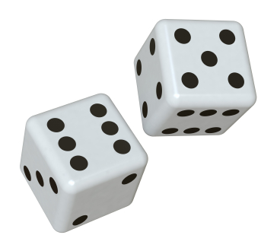
Roll the dice and translate the sentence
2 Usually I download music and I watch films | 3 Yesterday I read some articles and shared some photos | 4 Tomorrow I am going to listen to music and I will download films | 5 Usually I post comments and chat with my friends
6 Usually I do research for my job and I read stories | 7 Tomorrow I am going to download music and films | 8 Yesterday I posted comments and watched a funny video | 9 Yesterday I chatted with my friends and listened to music
10 Tomorrow I am going to share photos and videos and I will post comments | 11 Every day I listen to music and I upload photos | 12 Normally I upload photos and I post comments | Lé challenge – add an opinion

Slide 3
Tris!
Past
Future
Future
Past
Past
Future
Past
Past

